Slide 1


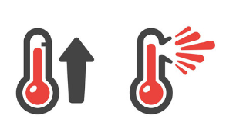



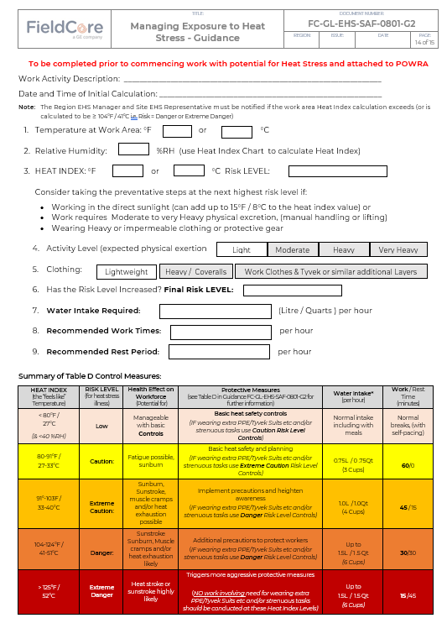
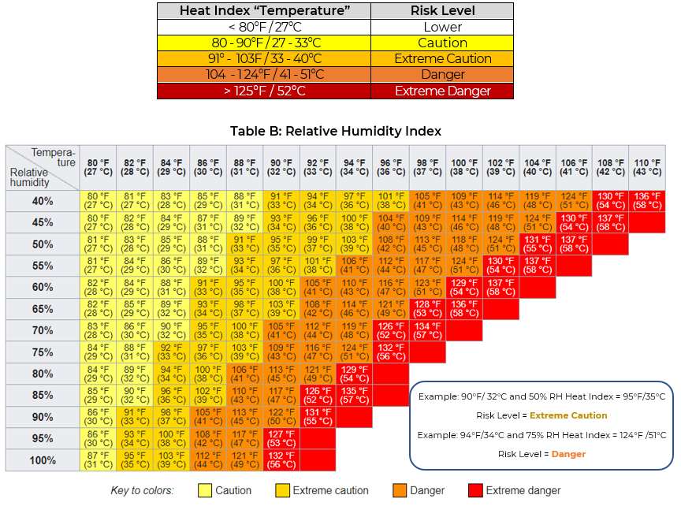

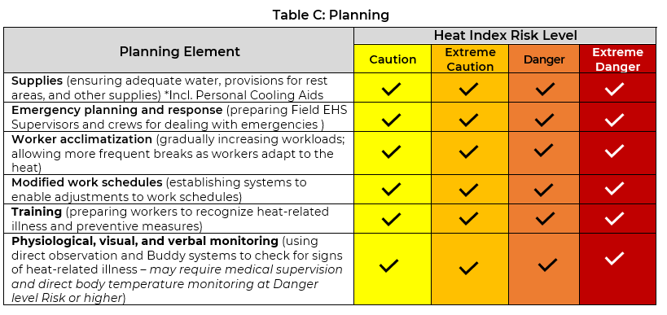
MANAGING EXPOSURE TO HEAT STRESS:
FC-GL-EHS-SAF-0801-G2 (Issue 2)
Key Elements & Changes
General update, includes: New Appendix B: Heat Index Risk Assessment New - FC-GL-EHS-SAF-0801-G2-1: Heat Index Calculator New - FC-GL-EHS-SAF-0801-G2-2: - Are You Hydrated? Several small changes to text to aid readability and planning
Reference Documents / Tools
Appendix A : Heat Stress – Prevention Recognition and First Aid New - Appendix B: Heat Index Risk Assessment: Hydration and Work/Rest Schedules New - FC-GL-EHS-SAF-0801-G2-1: Heat Index Calculator New - FC-GL-EHS-SAF-0801-G2-2: - Are You Hydrated? Industrial Hygiene Task Risk Assessment: Heat Stress here
Further Work / Support
SME Support: Ross Conway – FC Industrial Hygienist Full Implementation by: 31 October 2021
v1/August 2021

